Slide 1
Fatigue Risk Management Training
with Pulsar Informatics

Slide 2
Fatigue Risk Management
Comprehensive Training Materials for Operators
Copyright © 2019 Pulsar Informatics, Inc.

Slide 3
Note to Reader
This document was developed with funding and support from the National Safety Council. All content is copyright 2019 by Pulsar Informatics, Inc. and is made available to each active member of the National Safety Council (“You”) under a perpetual, fully paid up, worldwide, non-exclusive license subject to the limitations stated below.
You are permitted to use, copy, reproduce, amend, store (in both printed and electronic versions), and distribute this document to its affiliates, employees, contractors, shareholders and directors, for internal business purposes only.
The material in this document is made available on an as-is basis. Neither Pulsar Informatics nor the National Safety Council makes any representations or warranties of any kind, whether express, implied, statutory or otherwise, regarding the information contained within this document. Pulsar Informatics and the National Safety Council each disclaims all liabilities in connection with claims that may be related directly or indirectly to the implementation of fatigue risk management policies, procedures, or controls adopted by You. To the extent You intend to make medical, health, financial, legal, work-related, business-related, logistical, or other relevant important decisions based upon the information provided in this document, the You agree to do so at its own risk and that Pulsar Informatics and the National Safety Council shall be held harmless from and accept no liability for any errors, omissions, mistakes, or other faults resulting from such decisions or actions.
In no event shall either Pulsar Informatics or the National Safety Council be liable to You or any third party for consequential damages, including, without limitation, indirect, special, punitive, or exemplary damages for loss of business, loss of profits, business interruption, or loss of data arising out of or connected in any way with the use of or inability to use the information in this document.

Slide 4
Fatigue Science: Biological basis of fatigue

Slide 5



Science defines the causes of fatigue
Sleep Debt
Time of Day
Long Days
We all need about 7-9 hours of sleep to recharge our sleep battery every day.
When we go day after day without getting enough sleep we accumulate a sleep debt.
When we are awake and on duty at night we experience more fatigue because our bodies are programmed to be sleepy at night.
When we sleep we recharge our sleep batteries—resulting in reliable alertness for about 16 hours.
Fatigue impairments accelerate after being awake for longer than 17 hours.

Slide 6
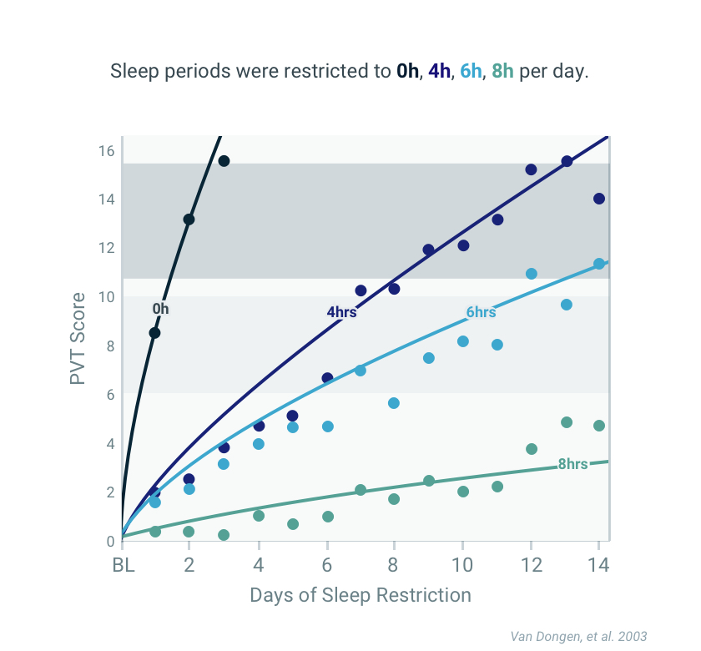
14 Day Sleep Restriction Study
Sleep Debt
When we go day after day without getting enough sleep we accumulate a sleep debt.

Slide 7
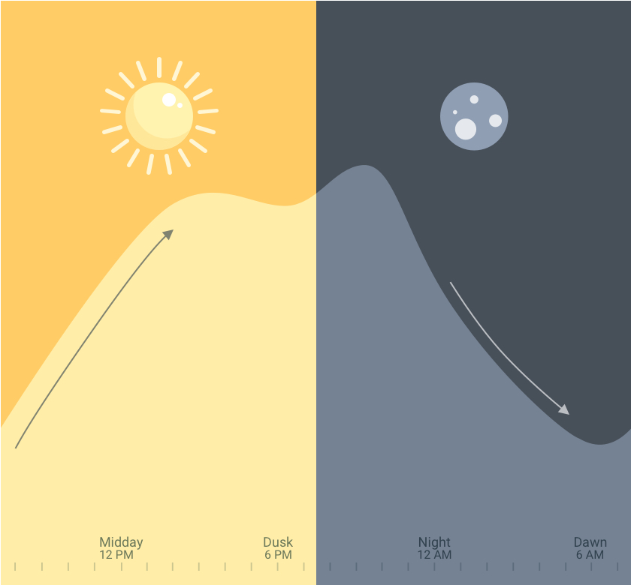
Time of Day
Our circadian rhythm, promotes alertness during the day and sleepiness during the night.
Alertness levels increase during the day
and decrease
during the night.

Slide 8
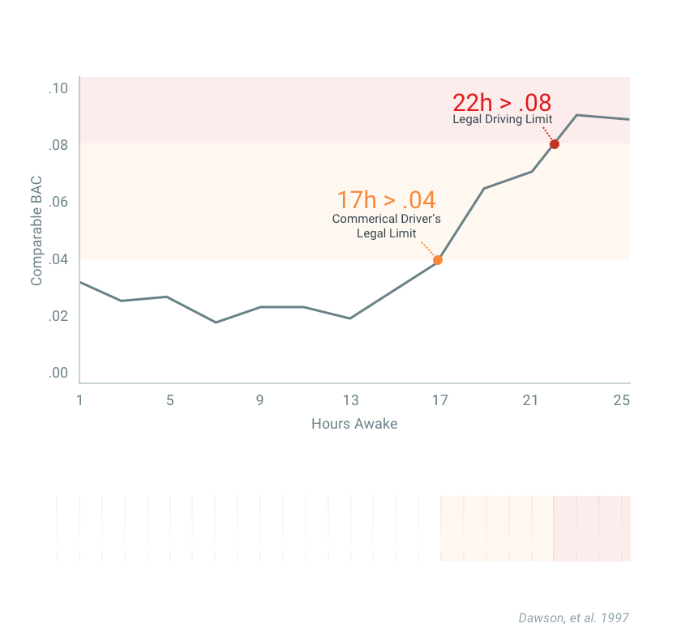
Lack of Sleep Mimics Blood Alcohol Concentration
Long Days
Fatigue deficits accelerate after being awake for longer than 17 hours.
For example, wake up at 6 AM and by 11 PM you may experience alertness impairments similar to a .04 BAC.
Extended wakefulness example:
Wake up, child care, errands, commute, etc.
Start
12h shift
Commute
home
6 AM
5 PM
5 AM

Slide 9
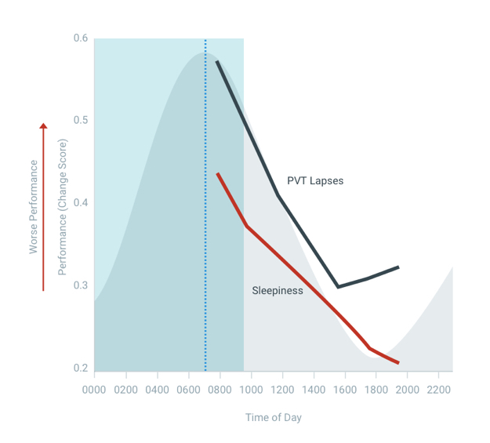
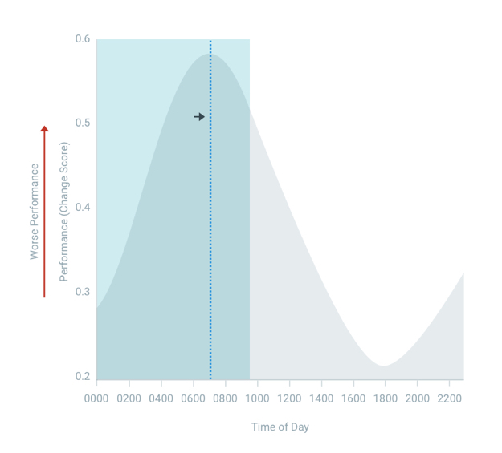
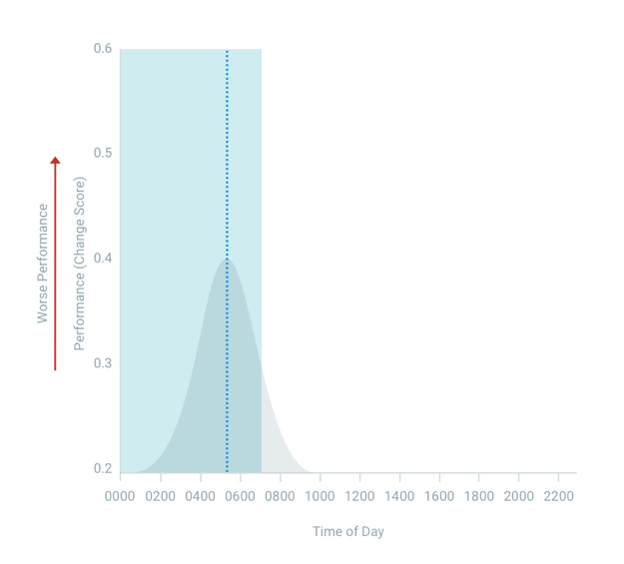
The WOCL expands with sleep debt.
When we have sleep debt we experience impairment early in the day.
Increased impairment
Increased sleep inertia
Increase range of hours impacted
Mollicone, et al. Time of day effects on neurobehavioral performance during chronic sleep restriction. Aviation, Space, and Environmental Medicine. 84(8): p. 735-744, 2010.

Slide 10
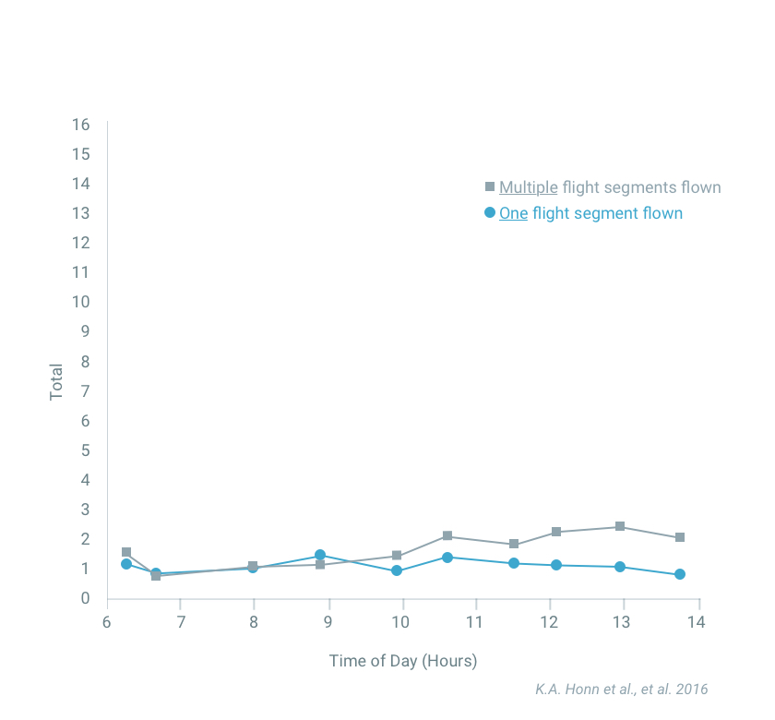
Workload
Number of PVT Lapses
Fatigue is primarily due to the amount and timing of our sleep and how long we have been awake. Workload is a factor but the effect is small compared to biological factors. This means that commute time and time awake before we go on shift are important considerations.

Slide 11
Risk Factors: Evidence of fatigue risk in operational settings

Slide 12
Risk factors for fatigue related accidents
Risks of fatigue-related errors and accidents stem from multiple interrelated and interacting aspects of work, rest, and sleep.
  Duration of work periods within a single day and over time,
  Time of day at which work occurs,
  Variation in the timing of work within and between weeks,
  Duration of sleep obtained on work days and on nonwork days,
  Frequency and duration of days off from work,
  Different vulnerabilities of workers to fatigue from these factors, and
  Volume and intensity of work.
SOURCE: Institute of Medicine (2009, pp. 218-219) citing the works of Dinges (1995), Rosa (2001), Drake et al. (2004), Folkard et al. (2005), and Van Dongen (2006).

Slide 13
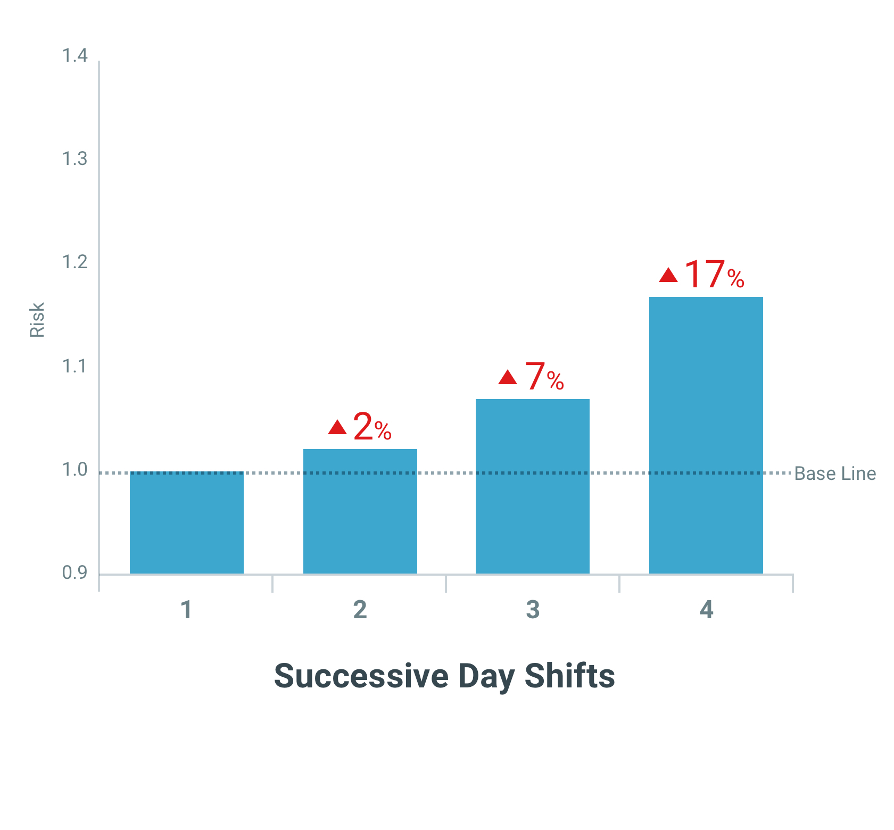
Increased risk
Risk of incidents increase across successive day shifts.
Fatigue Stressors:
Sleep debt
Meta-analysis conducted based on 5 large studies in different industries (Metallurgic plant, steel mill, engineering) Folkard, et al. 2006

Slide 14
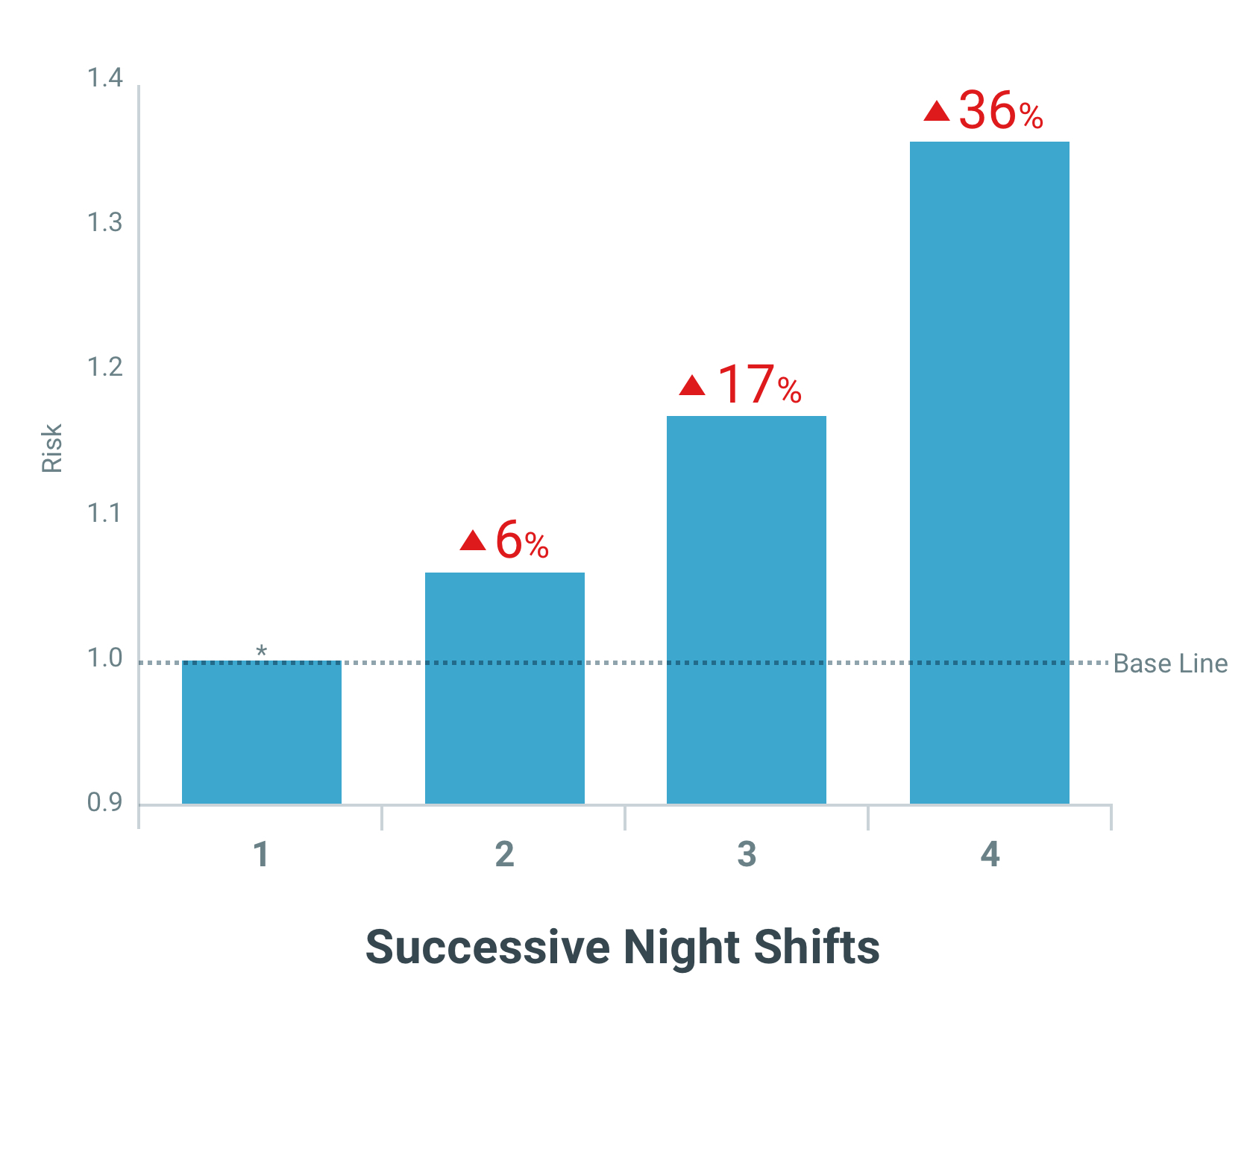
Increased risk
Risk of incidents increase across successive night shifts.
Fatigue Stressors:
Sleep debt
Night work
* Some studies show increased risk due to “first shift” effect.
Meta-analysis conducted based on 7 large studies in different industries (Mining, steel mill, dockers, engineering) Folkard, et al. 2006

Slide 15
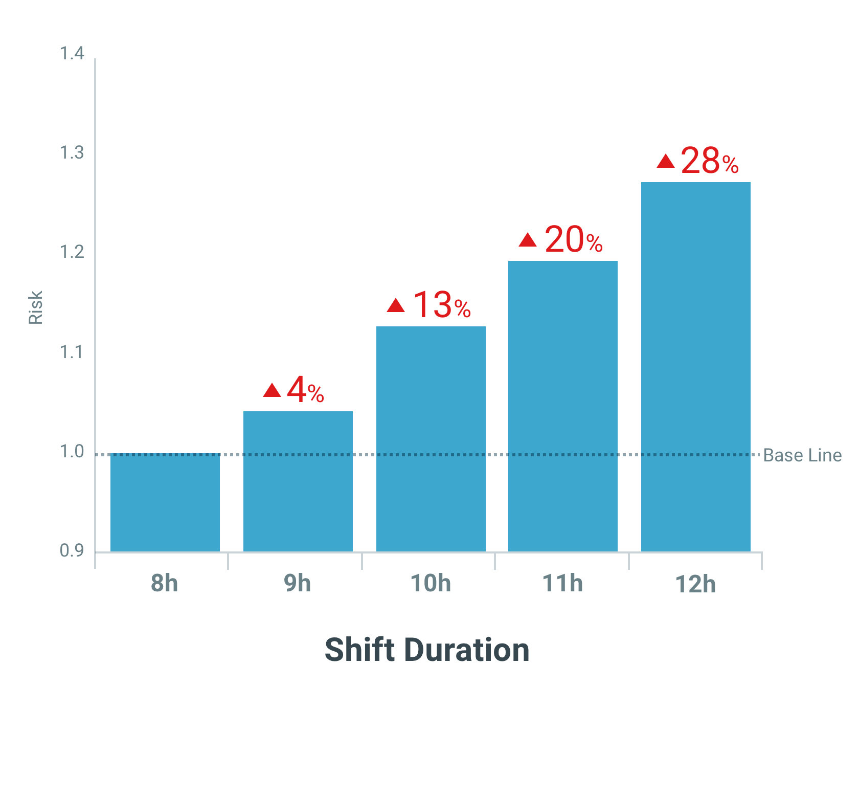
Increased Risk
Risk of incidents increases with extended work hours
Fatigue Stressors:
Night work (time of day)
Sleep debt
Extended wakefulness
Meta-analysis conducted based on 4 large studies in different countries (Sweden, USA, Germany) Folkard, et al. 2006

Slide 16
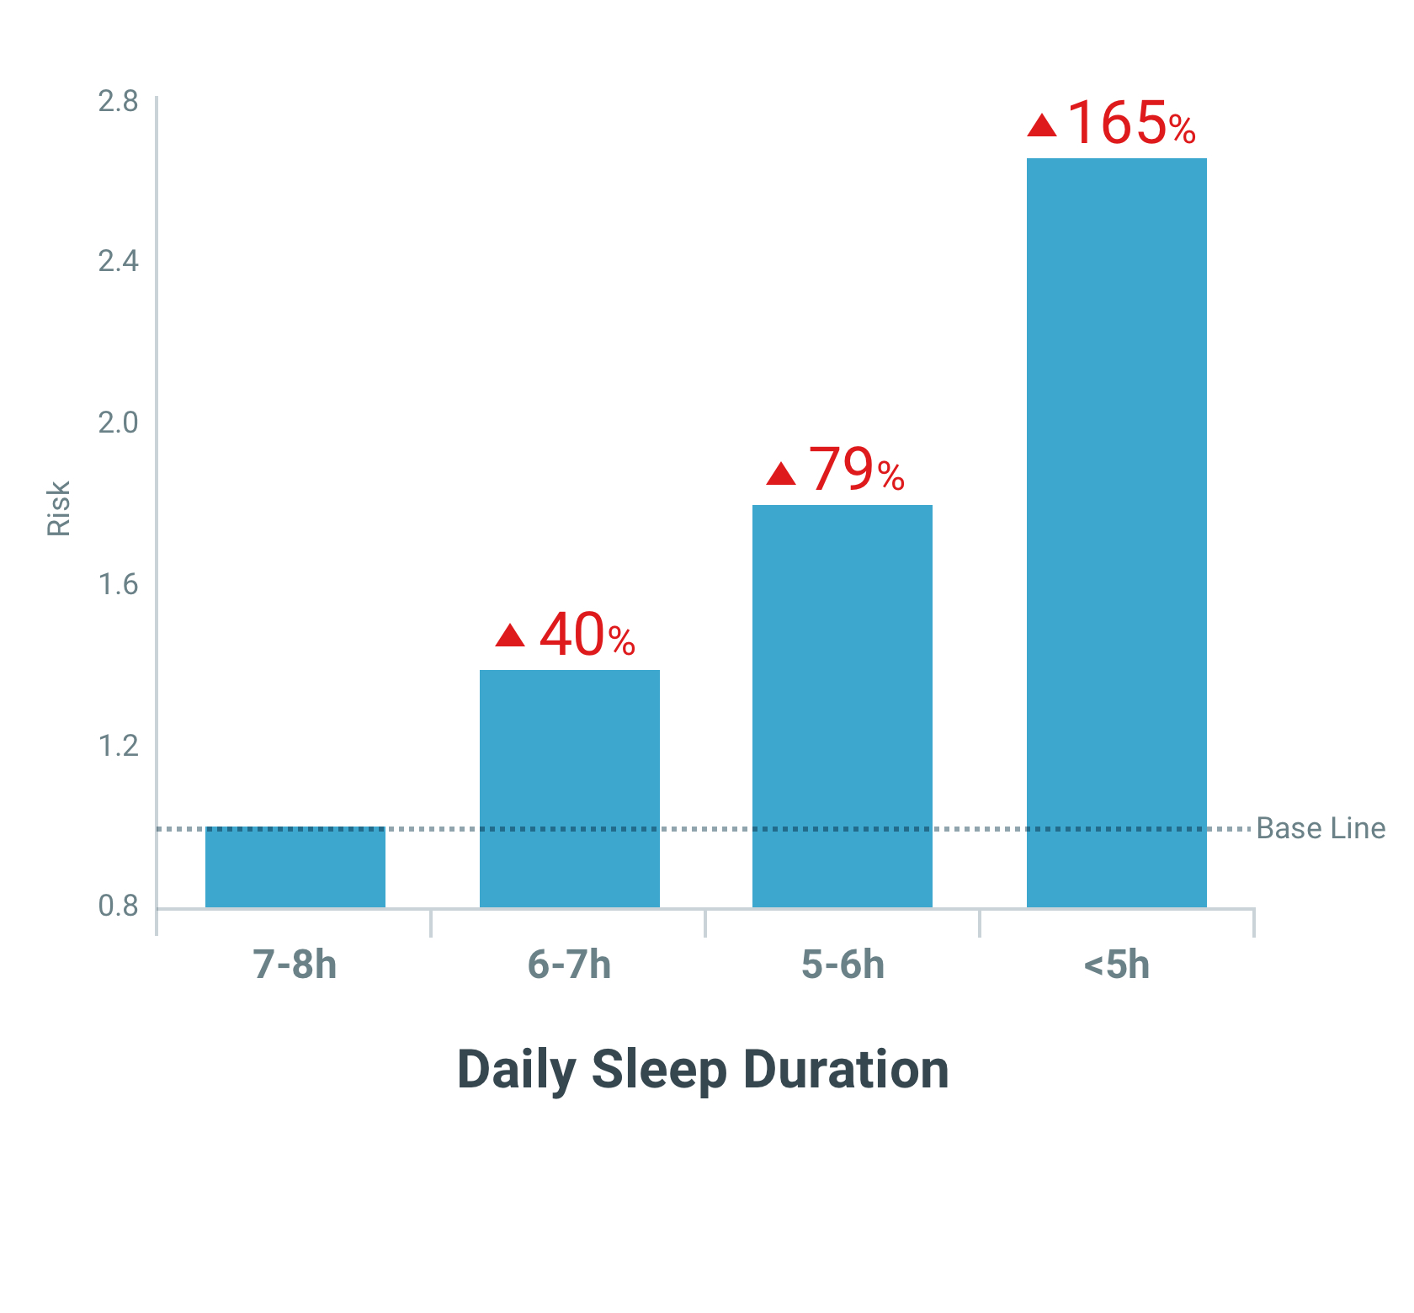
Increased risk
Risk of incidents increase as daily sleep duration decreases.
Fatigue Stressors:
Sleep debt
Extended wakefulness
Analysis based on the National Health Interview Survey (2004-2008).
A total of 74,415 persons reported on average sleep duration. (Lombardi, et. al. 2010)

Slide 17
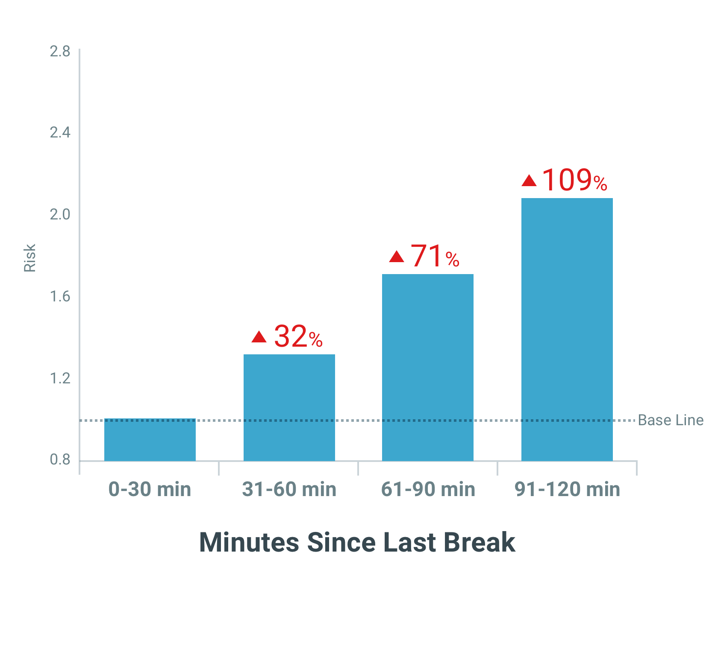
Increased Risk
Risk of incidents increases with extended time on task
Fatigue Stressors:
Night work (time of day)
Sleep debt
Extended wakefulness
Time on task
Meta-analysis conducted based on 4 large studies in different countries (Sweden, USA, Germany) Folkard, et al. 2006

Slide 18
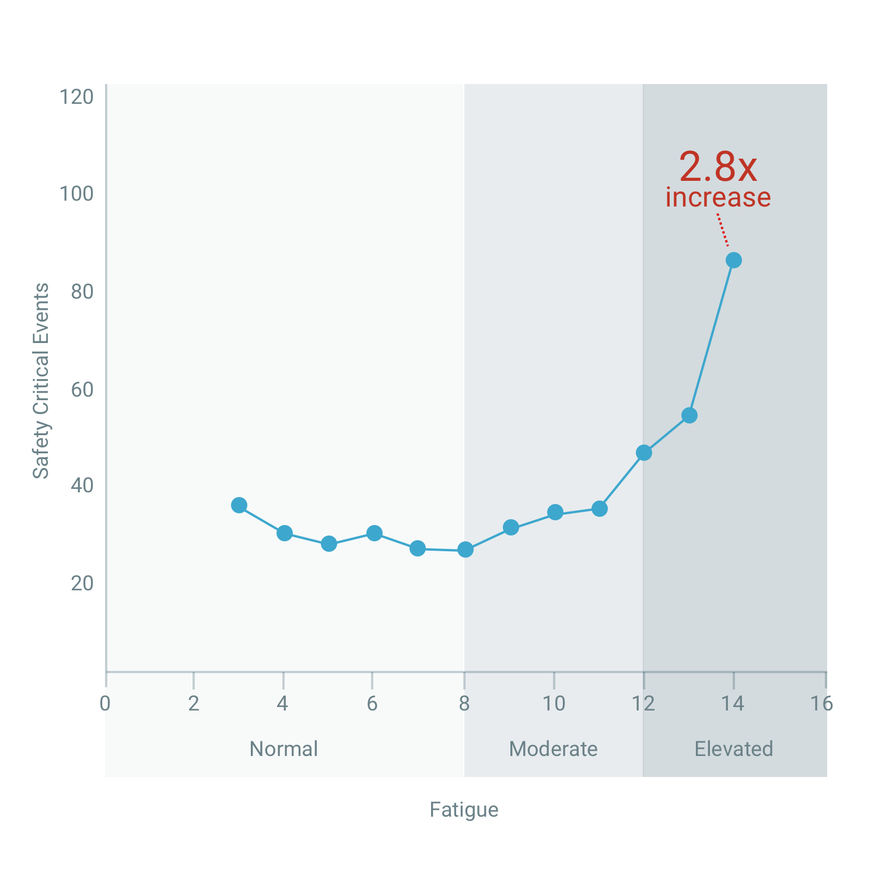
Increased Risk
Safety critical events increases as fatigue level increases.

Slide 19

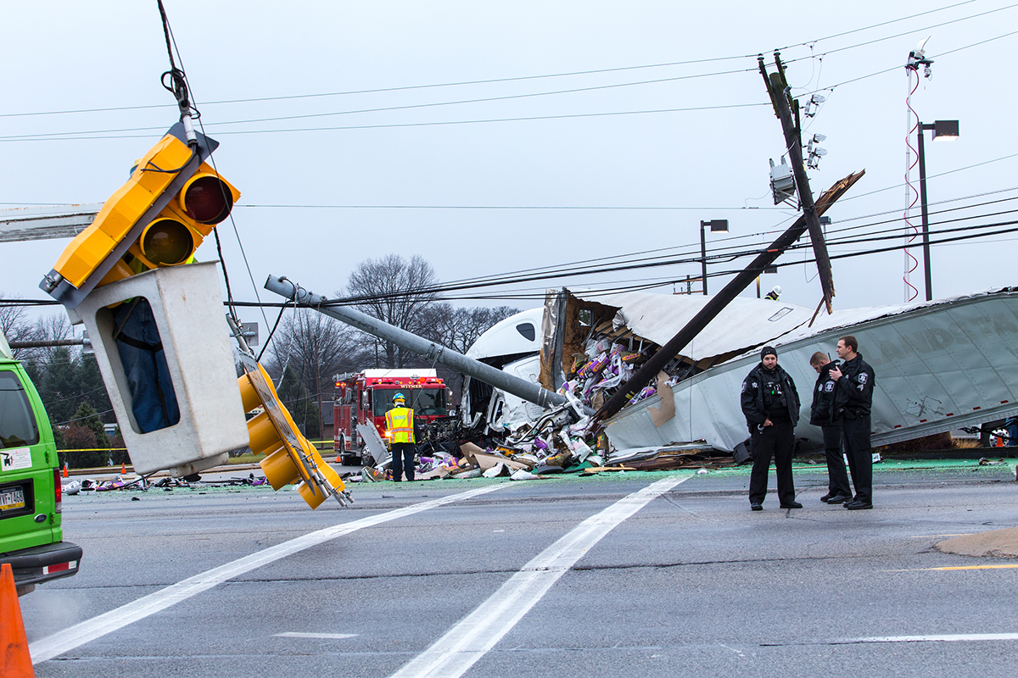
Fatigue causes 1 in 5 of all driving accidents – that’s more accidents caused than alcohol or drugs.
Active fatigue management does more than just protect your drivers. It can affect:
Company brand image
The safety of other drivers on the road
Customers and deadlines
Your bottom line

Slide 20
Best practices for shift work scheduling

Slide 21
Anatomy of a shift system
Key parameters related to shift system include:
Length of shift
Duration of shift
Start time of shift
Configuration of each shift type (days, evenings, nights)
Fixed vs. Rotating
Speed and direction of rotation (for rotating shifts)
When selecting a shift system key factors to consider include:
Sector specific regulations and guidance
Physical and cognitive demands
Handoff procedures
Employee’s commute time

Slide 22
Implementing and maintaining fatigue-optimized shift systems
Shift system implementation should be guided by SPIs and KPIs including the following:
Productivity measures
Quality measures
Safety incidents
High potential events (i.e., near misses)
Non-compliance incidents
Absenteeism
Employee attrition
Alertness and fitness for duty measures (e.g. PVT)
Biomathematical-model based metrics related to fatigue and risk (e.g., Workforce Fatigue Meter)
Irrespective of the baseline shift system, acute periods of elevated fatigue risk can be associated with hold-overs, call-ins, and overtime. An effective monitoring system with appropriate controls is needed to protect against periods of elevated fatigue risk based on the interaction of the shift system and the these operational events.

Slide 23
Approaches to monitor for fatigue and mitigate fatigue-related risk

Slide 24
Features of a comprehensive Fatigue Risk Management Program
Company responsibilities
Provide a clear fatigue risk management policy
Deliver fatigue education and training
Monitor duty patterns to ensure adequate rest opportunities are given
Monitor KPI and SPI to quantify fatigue risk
Monitor fitness for duty
Employee responsibilities
Manager their off-duty activities to ensure fitness for duty during work time
Actively monitor for signs of fatigue risk when on duty

Slide 25
Key Elements of Fatigue Risk Management Policy
Management Commitment
Promote effective fatigue risk reporting
Provision adequate resources for fatigue risk management program
Pursue excellence with quality assurance practices
Shared
Responsibility
Management and supervisors to create transparent reporting culture, create schedules with opportunity for rest, and monitor for fatigue hazards
Employees to set aside adequate time for restorative sleep while off duty
Safety Objectives
and SPIs
Safety objectives stated in terms of quantified Safety Performance Indicators (SPIs)
Each SPI linked to operations to provide leading indicator of fatigue risk
Non-Punitive
Reporting
No barriers to creation and communication of information by employees
No disciplinary action against any employee who reports safety incident or risky operational situation

Slide 26
Education and training
Initial & Recurring Training
New hires should receive fatigue risk education and training in how fatigue risks are monitored in the operation as part of their onboarding process
All employees should receive annually recurring fatigue risk education and training
Training Methods
Distributed learning through a smartphone app should complement live webinars and traditional classroom instruction
Training Content
Learning objectives should be mapped out in terms of roles at the organization, so that the training content is appropriate for each individual
Case studies of fatigue-related safety incidents within the operator’s industry are very effective and should be included

Slide 27
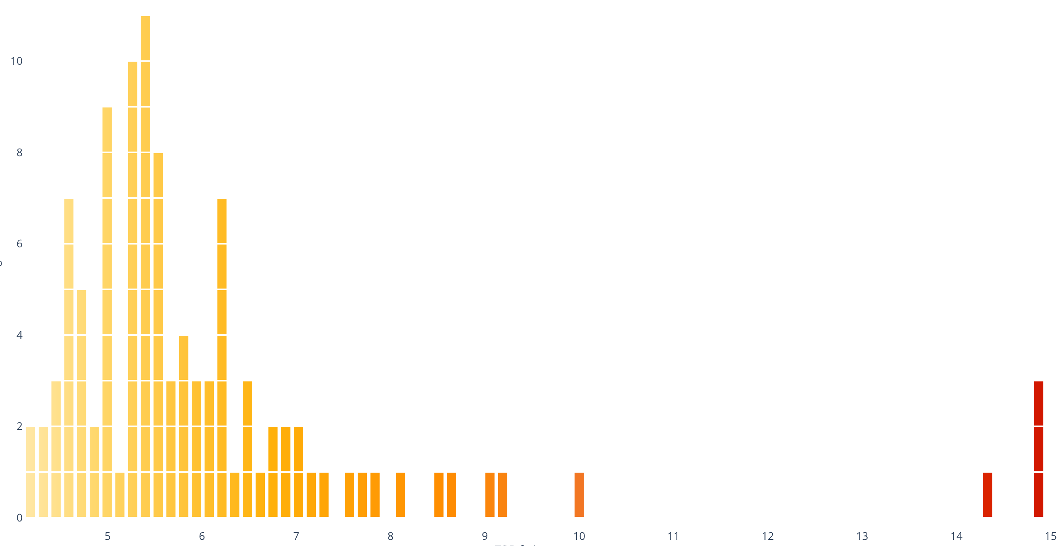
Monitor shift patterns
Approaches based on biomathematical models enable monitoring of fatigue risk associated with work rest patterns.
Shifts with
elevated fatigue risk
No. of Shifts
Fatigue Risk (increases to the right)
Notes:
Discussion: Is there another way to communicate this w/o equations?

Slide 28
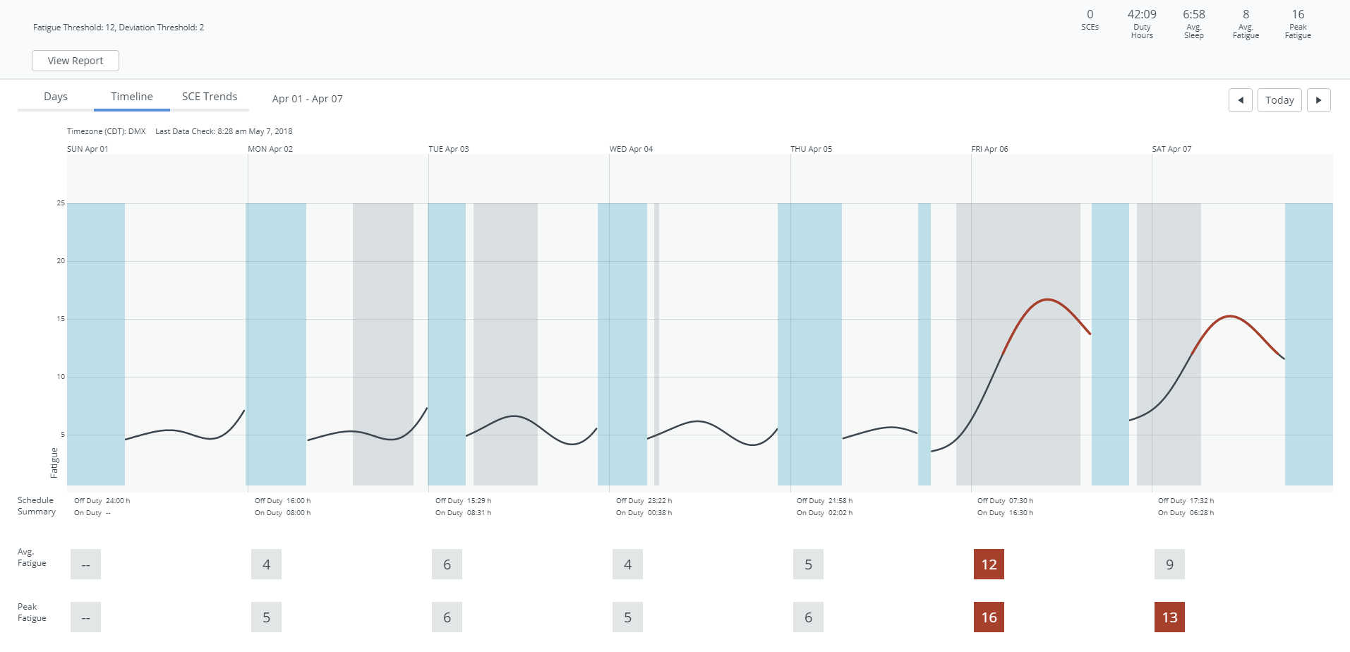
Monitor KPI and SPI to quantify fatigue risk
Approaches that quantify the extent to which fatigue contributed to safety incidents using objective and self-report data.
More Fatigue Risk
injury event

Slide 29
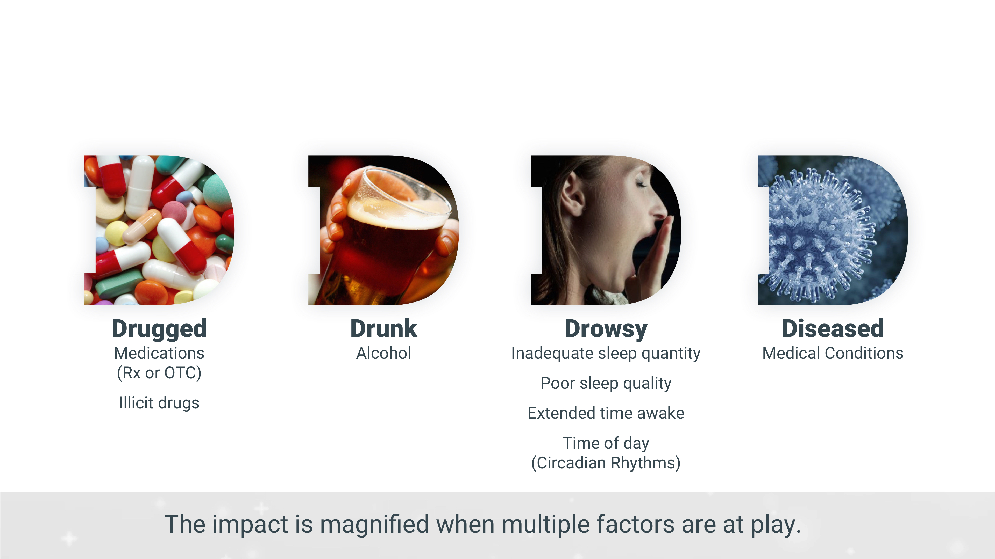
Monitor fitness for duty
Fitness for duty monitoring approach should be based on objective quantitative framework that is effective, fair to employees, and protects employee rights
Causes of Cognitive Impairment: the Four Ds
Copyright © 2019 Pulsar Informatics, Inc.
29

Slide 30
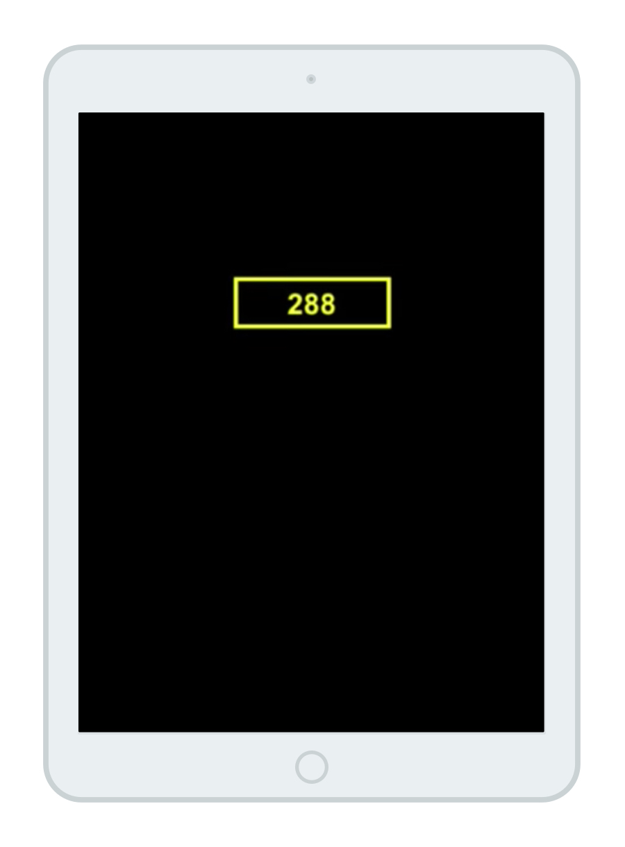
Psychomotor Vigilance Test (PVT) is an example of an objective quantitative approach to assess fitness for duty
Test features:
  Measures vigilant attention and psychomotor speed
  No learning effects
  Unaffected by aptitude differences
Validated to be sensitive to:
  Total and chronic partial sleep deprivation
  Night work
  Sleep inertia
  Drug effects

Slide 31
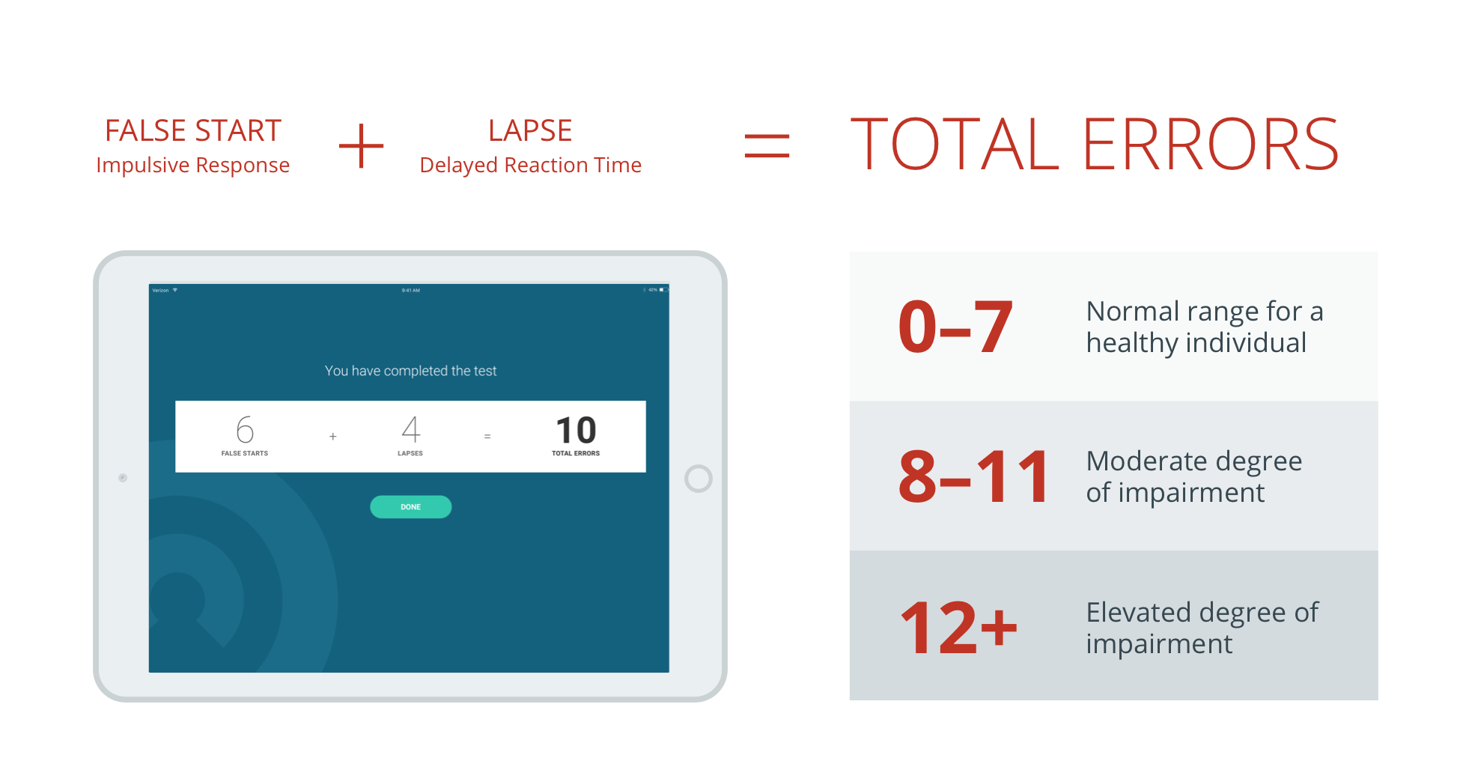
Interpreting the Score

Slide 32
Case Study: Use of Psychomotor Vigilance Test in fitness for work assessments

Slide 33
Pilot program using PVT to assist with Fitness for Duty assessments
Need: A major petrochemical producer was seeking a means to screen for alertness deficits among workers in designated safety-sensitive positions. Employees already had periodic fitness for duty assessments; however, the company had identified a need to add an objective test of alertness to clinical examinations.
Approach: The PVT was used to provide a quantitative objective assess of alertness to aid clinical staff in making fitness for duty assessments.
Results: 3 out of 97 employees in the pilot program had alertness deficits. Upon further examination it was discovered that each of these workers was experiencing a specific health or personal issue that was contributing to a state of impaired alertness. None of these issues had been identified through the routinely administered medical exam. Work limitations were made until issues could be resolved and workers could safely resume their work.
Source: Lerman S., Mollicone D., and Coats S.. Use of the Psychomotor Vigilance Test in Fitness for Work Assessments. Journal of Occupational and Environmental Medicine: August 2017 - Volume 59 - Issue 8 - p 716–720.

Slide 34
Results from pilot program
Distribution of PVT Error Scores from N=97 Safety Critical Employees
High degree of impairment
Untreated acute insomnia
Under-treated sleep apnea
Multiple conditions including undetected blocked coronary artery

Slide 35
For help with implementing a Fatigue Risk Management training program or for more information, please contact:
+1 215.520.2630
info@pulsarinformatics.com
pulsarinformatics.com

Slide 36
For more resources on fatigue risk management, please visit the Employer Toolkit
nsc.org/FatigueAtWork

