Slide 1
Slips, Trips & Falls
For use in conjunction with 5-Minute Safety Talk
Notes:
Slips, Trips and Falls

Slide 2
In 2015, the U.S. Bureau of Labor Statistics reported over 223,000 non-fatal falls on the job.
The majority of those falls -149,180 were not from a height or elevation.
Workers fell on the same level due to slipping on a slick surface or from tripping over a hazard.
Notes:
In 2015, the U.S. Bureau of Labor Statistics reported over 223,000 non-fatal falls on the job. The majority of those falls—149,180—were not from a height or elevation. These workers fell on the same level due to slipping on a slick surface or from tripping over a hazard in the work area.

Slide 3
Many of these incidents resulted in missed work days and injuries including:
Fractures
Sprains and strains
Tears
according to National Safety Council Injury Facts® 2016 Edition
Numbers could be higher due to underreporting!
Notes:
Many of these incidents resulted in missed work days and injuries including factures, sprains, strains and tears, according to 2016 Injury Facts®, the statistical report on unintentional injuries by the National Safety Council. Due to underreporting, the number could be even higher.

Slide 4
Distractions & Hazards
Slips, trips and falls are the No. 2 cause of nonfatal disabling injury in the workplace following overexertion.
They are PREVENTABLE when you are AWARE of your surroundings
Be aware and acknowledge the area you’re walking through - even if you walk through it every day
Has anything changed?
Is there a new potential hazard - slippery floor, stack of boxes - that wasn’t there yesterday?
Notes:
Slips, trips and falls are the No. 2 cause of nonfatal disabling injury in the workplace following overexertion. Fortunately, by being aware of our surroundings, slips, trips and falls are easily preventable. It starts with awareness. We’re always on the move so it can become second-nature to go into autopilot when walking, especially in familiar places like the workplace. Take a moment to acknowledge the area you’re walking through, even if you walk through it every day. Has anything changed? Is there a new potential hazard, such as a slippery floor or a stack of boxes, that wasn’t there yesterday?

Slide 5
Distractions
FACT:
Distracted walking incidents involving cell phones accounted for more than 11,100 injuries between 2000 and 2011.
Nearly 80% of the injuries were due to a fall
http://www.nsc.org/learn/safety-knowledge/Pages/news-and-resources-pedestrian-safety.aspx
Notes:
Distraction is another factor we don’t always recognize. Eating on the go, rushing to a meeting and using the phone—whether it’s talking, checking a work email or getting the latest score from the game—are all distractions that increase the risk of a trip or fall. Don’t rush and focus on getting to your destination safely.
FACT: Distracted walking incidents involving cell phones accounted for more than 11,100 injuries between 2000 and 2011. Nearly 80% of the injuries were due to a fall

Slide 6
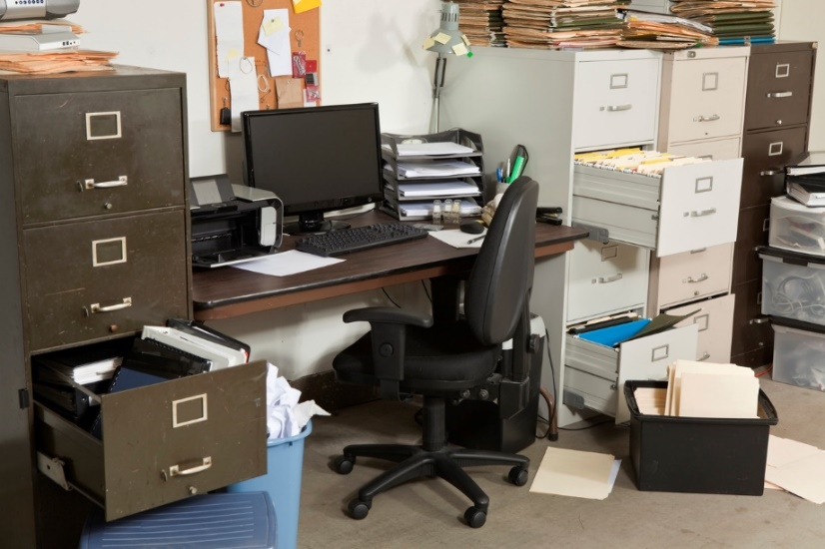
Other Hazards
Wet floors
Uneven surfaces - tile & carpet
Ice
Limited visibility around corners
Cluttered work areas
Not using handrail in stairways
Cords across pathways
Carrying a load that’s too heavy and/or obstructs vision
Notes:
Other hazards include:
• Wet floors
• Uneven surfaces (tile, carpet, etc.)
• Ice, which can often be difficult to see
• Limited visibility around corners
• Cluttered work areas
• Not using the handrail in stairways
• Cords across pathways
• Carrying a load that’s too heavy and/or obstructs vision

Slide 7
Report Hazards & Falls
An important step in preventing slips, trips and falls from happening in the future is reporting them when they occur!
Employees are best suited to
identify and report hazards as
they are familiar with work areas
No blame
Report all hazards, no
matter how minor they seem
FACT:
New employees - workers with less than one year of service - account for 30% of non-fatal injuries from falls.
Notes:
An important step in preventing slips, trips and falls from happening in the future is reporting them when they occur. Some employees may feel embarrassment or even fear retribution for reporting an incident. New employees—workers with less than one year of service—disproportionately account for 30% of non-fatal injuries from falls. An employer shouldn’t place blame on any employee who falls, especially since some falls are related to a person’s physical ability. In fact, many causes of slips, trips and falls can be prevented by employers, but employees—who are most familiar with their work areas—are best suited to identify and report hazards. Employers need to make safety a part of their culture and encourage reporting of all hazards, no matter
how minor they seem. This is the best way to prevent incidents before they happen.

Slide 8
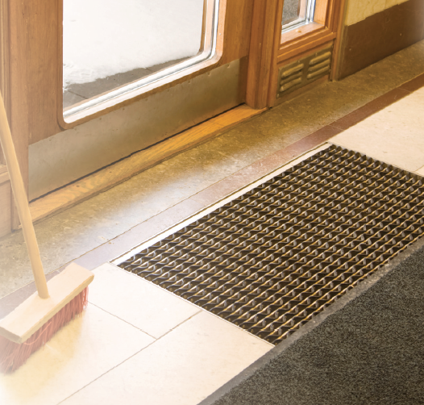
Focus on Problem Areas
Concentrate on the areas where the most incidents occur:
Doorways/entry ways
Ramps
Cluttered hallways
Heavy traffic areas
Uneven surfaces
Areas prone to wetness and spills
Notes:
Focus on problem areas…Concentrate on the areas where the most incidents occur:
• Doorways/entry ways • Ramps • Cluttered hallways • Heavy traffic areas • Uneven surfaces • Areas prone to wetness and spills.
Always ensure that floors are clean, well-maintained and fitted with slip-resistant material when necessary. The Occupational Safety and Health Administration (OSHA) also recommends workers wear slip-resistant footwear.

Slide 9
Getting everyone on-board
Making sure the work environment is free of hazards and properly maintained is important in preventing slips, trips and falls, but it is only part of the solution. Commitment to a safe environment including communication between managers and their workers is a critical component.
Notes:
Making sure the work environment is free of hazards and properly maintained is important in preventing slips, trips and falls, but it is only part of the solution. Commitment to a safe environment including communication between managers and their workers is a critical component.

Slide 10
Training will teach employees to make sure work areas are clear and clean and any potential hazards are identified with proper signage.
Encourage employees to make behavioral
changes to reduce the risk of falls:
be attentive
don’t carry heavy loads
keep work areas clutter-free
Companies that create a safe working environment along with a strong, focused safety culture usually see incident rates decline.
Notes:
Training will teach employees to make sure work areas are clear and clean and any potential hazards are identified with proper signage. Encourage employees to make behavioral changes to reduce the risk of falls: be attentive, don’t carry heavy loads and keep work areas clutter-free. Companies that create a safe working environment along with a strong, focused safety culture usually see incident rates decline.

Slide 11
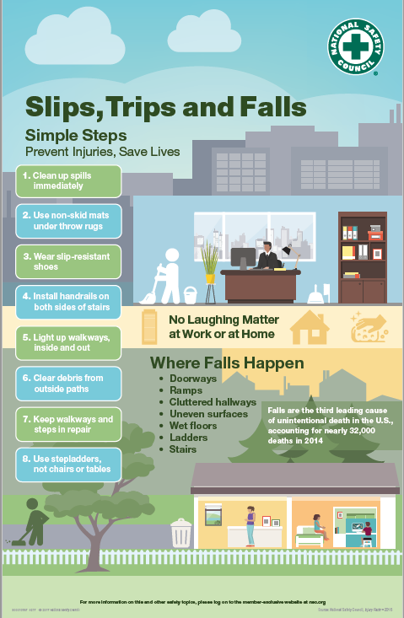
Poster
Slips, trips and falls are no laughing matter.
Hang this poster in high traffic areas to increase awareness and help prevent injuries at your workplace.
Notes:
With NSC membership comes access to member-exclusive resources. Besides the 5-Minute Safety Talk and this Presentation, there are many other resources available on Slips, Trips and Falls. The Safety Team Toolkit contains this poster. Hang it in high traffic areas to increase awareness on how to prevent Slips, Trips and Falls.

Slide 12
2-Minute Safety Video
Help prevent slips, trips and falls by watching this 2-Minute Safety Video at your next safety meeting or share the link with your teams.
Slips, Trips and Falls are a leading cause of injury, but common-sense practices work in prevention.
Visit: https://www.youtube.com/watch?v=HWWaJpzDEtg&feature=youtu.be
Notes:
There is a link to the 2-Minute Safety Video in the toolkit.
( Link: https://www.youtube.com/watch?v=HWWaJpzDEtg&feature=youtu.be )

Slide 13
Checklist
Slips, trips and falls are preventable!
Share this checklist to help everyone reduce tripping hazards.
Notes:
Share the Safety Checklist to help everyone reduce tripping hazards.

Slide 14
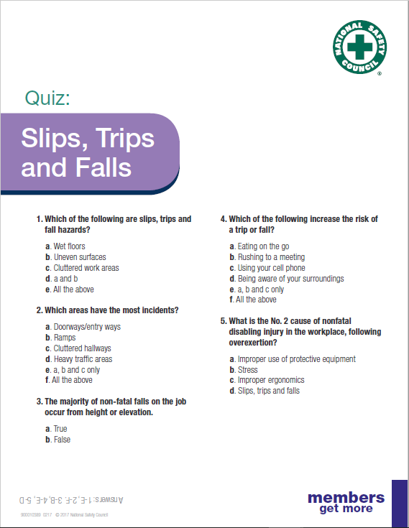
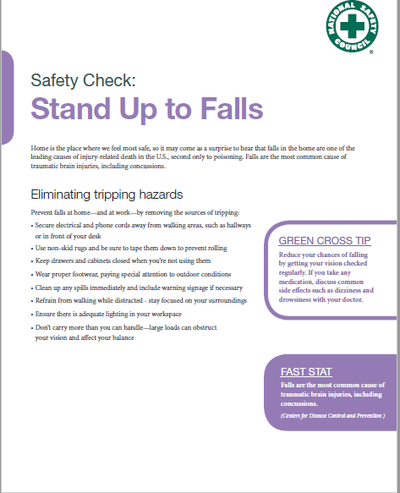
Tip Sheet & Quiz
Take a safety check with the Stand Up to Falls tip sheet and make sure everyone has paid attention with a quiz on how to prevent slips, trips and falls.
Notes:
Additionally, there is a tip sheet and quiz. Take a safety check with the Stand Up to Falls tip sheet and make sure everyone has paid attention with a quiz on how to prevent slips, trips and falls.

Slide 15
For more member-exclusive safety presentations, webinars, posters and resources sign in at nsc.org/members
Customer Service – (800) 621-7619
Outside U.S. – +1-630-775-2056
Email us at:
MEMBERSHIPINFO@nsc.org
Notes:
Find more member-exclusive safety presentations, webinars, posters and resources at nsc.org/members
For discussion:
Questions
Observations & Concerns
Safety Action Plan

