Slide 1
Preventing the Spread of Colds & Flu
For use in conjunction with 5-Minute Safety Talk

Slide 2
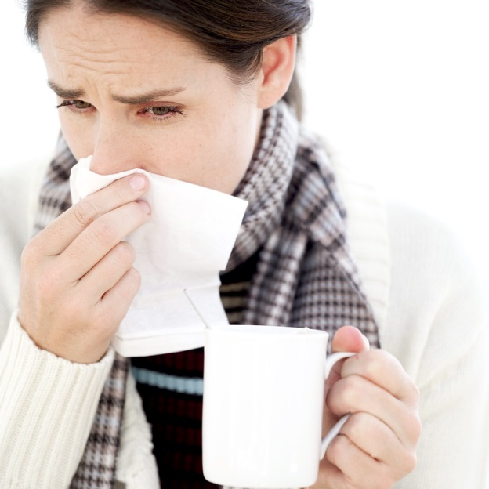
Flu Season
It is estimated that one billion colds are caught annually in the United States.
According to the Centers for Disease Control and Prevention, 5% - 20% of the U.S. population catches the flu annually.
Notes:
It is estimated that one billion colds are caught annually in the United States.
According to the Centers for Disease Control and Prevention, 5 to 20 percent of the U.S. population catches the flu annually.

Slide 3
The flu season in the U.S. ranges from:
While it is a myth that cold temperatures cause colds, it’s true that cold weather keeps people indoors, making exposure more likely.
November- April
Notes:
The flu season in the U.S. typically ranges from November to April.
While it is a myth that cold temperatures cause colds, it is true that cold weather keeps people indoors, making exposure more likely.

Slide 4
Tips to Avoid Colds & Flu
Clean & wipe down shared surfaces such as countertops, keyboards & phones
Avoid touching your mouth, nose & eyes, & wash hands thoroughly and often
Drink plenty of water to stay hydrated
Get a flu shot if possible – it’s most important for children & elderly
Ask your doctor about vitamin supplements to help support your immune system
Try to avoid people who are sick & know when to stay home if you become sick
Exercise moderately to maintain a healthy immune system
Eat healthy foods to strengthen your immune system
Get plenty of rest
Notes:
Here are some tips to help you avoid colds and the flu:
• Clean and wipe down shared surfaces such as countertops, keyboards and phones.
• Avoid touching your mouth, nose and eyes, and wash hands thoroughly and often.
• Get a flu shot if possible (it is most important for children and the elderly).
• Eat healthy foods to strengthen your immune system.
• Exercise moderately to maintain a healthy immune system.
• Ask your doctor about vitamin supplements to help support your immune system.
• Drink plenty of water to stay hydrated.
• Get plenty of rest.
• Try to avoid people who are sick, and know when to stay home if you become sick.

Slide 5
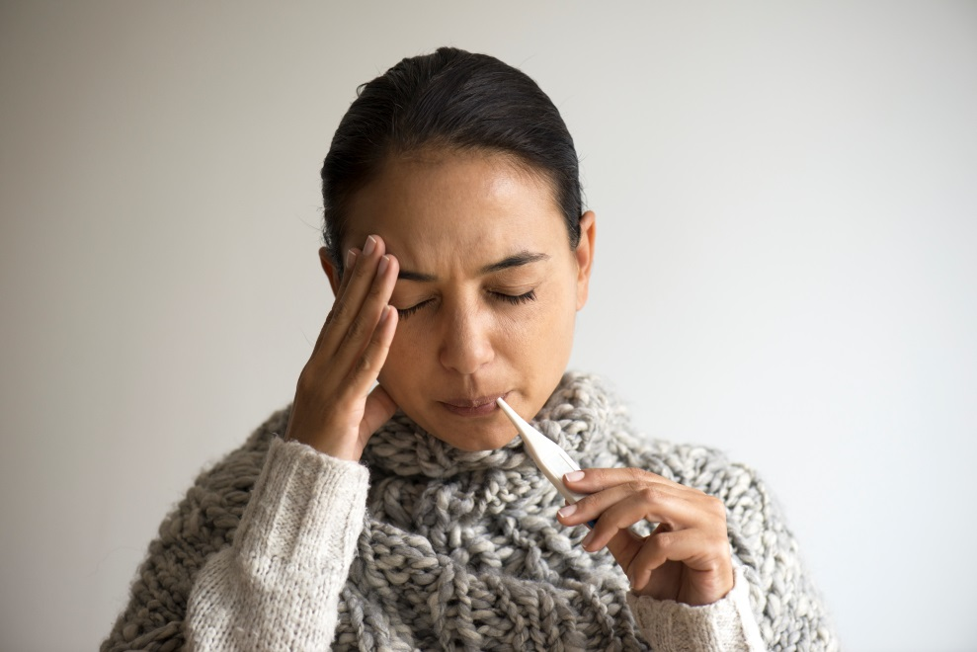
Flu Symptoms
High fever 102-104 degrees Fahrenheit
Headache
Extreme fatigue
Dry cough and sore
throat
Runny or stuffy nose
Muscle aches
Nausea, vomiting and diarrhea
Notes:
The symptoms of the flu are:
High fever 102-104 degrees Fahrenheit
Headache
Extreme fatigue
Dry cough and sore throat
Runny or stuffy nose
Muscle aches
Nausea, vomiting and diarrhea

Slide 6
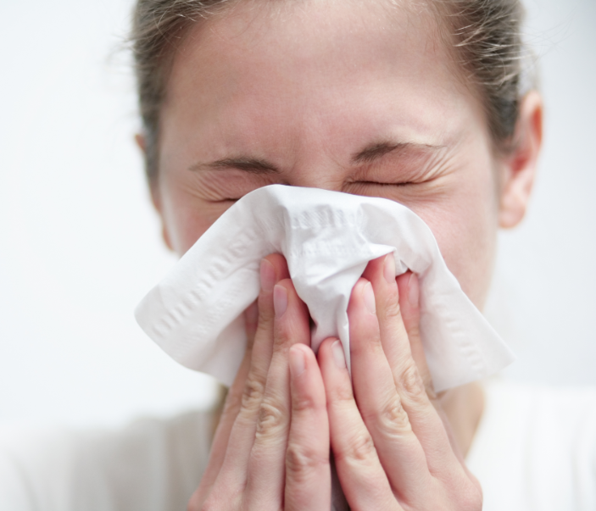
Cold Symptoms
Sore throat
Cough, chest discomfort
Mild fatigue
Fever & headache are rare
Runny nose
Notes:
Cold Symptoms include:
Sore throat
Cough, chest discomfort
Mild fatigue
Fever and headache are rare
Runny nose

Slide 7
Complications of the Flu
Most at Risk:
Children - Elderly - People with certain health conditions
Complications may Include:
Pneumonia, dehydration & worsening of conditions like congestive heart failure, asthma, diabetes or sinus & ear infections in children
Notes:
Usually children and the elderly, or people with certain health conditions are at risk for serious flu complications. Complications may include bacterial pneumonia, dehydration and worsening of chronic medical conditions, such as congestive heart failure, asthma or diabetes. Children may develop sinus problems and ear
infections.

Slide 8
Stop the Spread of Germs
Germs are spread in
respiratory droplets
caused by coughing
and sneezing.
They usually spread
from person to person,
though sometimes people can become infected by touching something contaminated by germs.
Notes:
Germs are spread in respiratory droplets caused by coughing and sneezing. They usually spread from person to person, though sometimes people can become infected by touching something contaminated by germs.

Slide 9
Infection Can Occur…
1 Day Before &
Up to 5 Days After
Becoming Sick
Notes:
Most healthy adults may be able to infect others beginning one day before symptoms develop and up to five days after becoming sick.

Slide 10
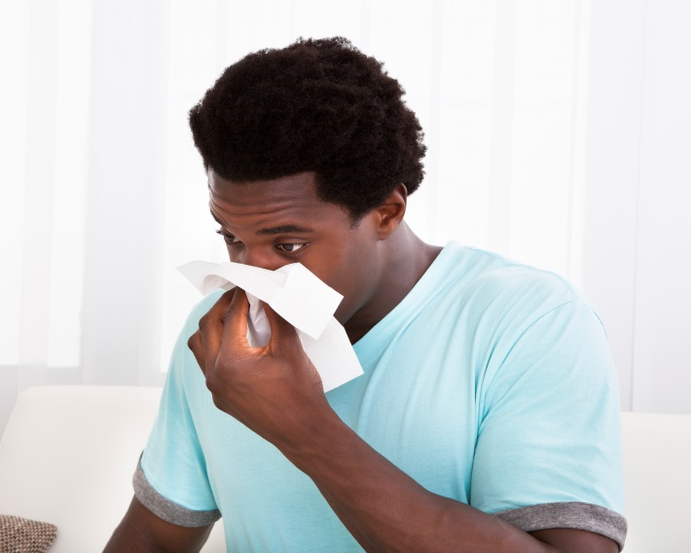
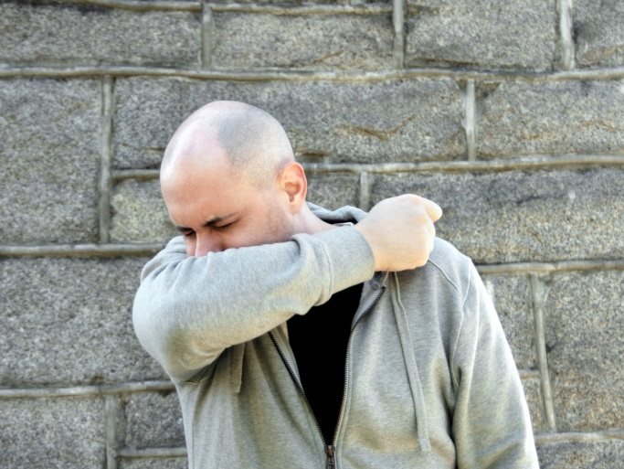
Prevent the Spread of Germs
Cover your nose & mouth when you sneeze or cough
Use tissues when you sneeze or have sniffles
Sneeze into your sleeve if tissues aren’t available
Notes:
To prevent the spread of germs, cover your nose and mouth when you sneeze or cough. Use tissues when you sneeze or if you have the sniffles. If tissues aren’t available,
sneeze into your sleeve – it is another great weapon against germs.

Slide 11
Prevent the Spread of Germs
Toss your tissues in the trash
Wash hands frequently
Any kind of soap is effective in removing germs if you vigorously rub your hands together for at least 15-30 seconds and rinse well under running water.
Notes:
But don’t just throw tissues on the floor to pick up later; toss them in the trash and wash your hands frequently. Any kind of soap is effective in removing germs if you vigorously rub your hands together under running water for at least 15-30 seconds.

Slide 12
Work or Stay Home?
Let common sense be your guide!
Stay home if you:
Have a fever
Cannot control your sneezing & coughing
When in doubt, call you physician!
Don’t overtax your immune system.
Common colds become more serious bacterial infections such as sinusitis - and influenza can turn into pneumonia.
Notes:
Cold and flu are the most common contagious diseases in the workplace. But should you go to work sick or stay home? There are few
hard and fast rules to help you decide. Health experts and HR professionals say personal judgment and common sense should be your
guide.
You should stay home if you have a fever because you are probably the most contagious at that time, or if you cannot control your sneezing and coughing.
When in doubt, call your physician. And don’t overtax your immune system by going to work if you’re really suffering. Common colds can
become more serious bacterial infections such as sinusitis, and influenza can turn into pneumonia.

Slide 13
Over-the-Counter Medications
Check label & ingredients
Talk to pharmacist
Can negatively react with your regular medications.
Some cold and flu medicines (with antihistamines) can make you drowsy and that can be dangerous when driving or working around any kind of machinery.
Notes:
If you decide to work and treat your symptoms with over-the-counter medications, check the label and ingredients, and talk to your
pharmacist. Some cold and flu medicines (with antihistamines) can make you drowsy, and that can be dangerous when you drive a vehicle or work around any kind of machinery. Other over-the-counter medications can negatively react with maintenance medications you take regularly.

Slide 14
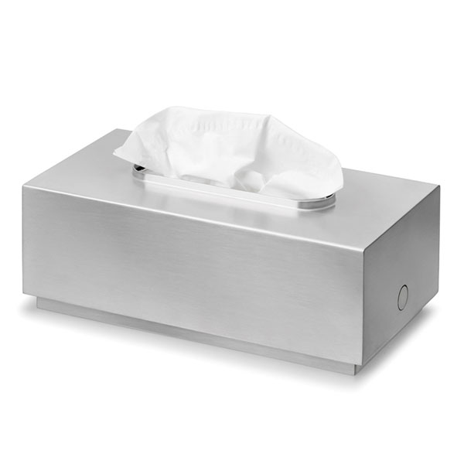
It’s Your Decision
Supervisors have the right and responsibility to
tactfully and privately tell a sick employee to
go home - if necessary.
Use common sense and courtesy;
stay home when sick.
Notes:
Most companies have formal sick day or attendance policies. HR professionals say that supervisors have the right and responsibility
to tactfully and privately tell an obviously sick employee to go home, if necessary. The ultimate decision rests with the individual
worker. Most employers expect their workers to use common sense and courtesy and stay home when they are very sick.

Slide 15
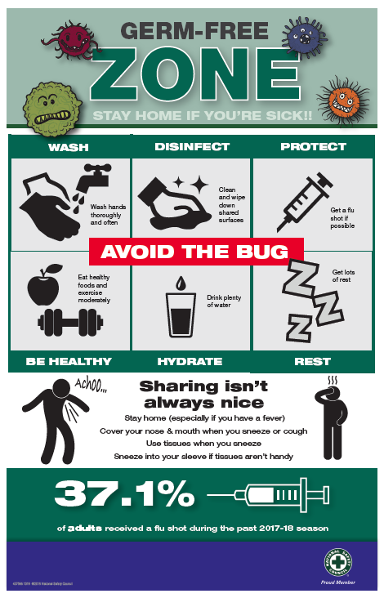
GERM-FREE ZONE Poster
Display this poster in high traffic areas as a reminder to everyone of the best ways to avoid germs and to
STAY HOME if sick.
Notes:
Display this poster in high traffic areas as a reminder to everyone on the best ways to avoid germs and to STAY HOME if sick.

Slide 16
Quiz
Take a quiz and find out who knows their cold and flu facts.
The quiz and poster can be found in the Cold and Flu Toolkit on the Member Exclusive Workplace Safety Team Toolkits page.
Notes:
Take a quiz and find out who knows their cold and flu facts
The quiz and poster can be found in the Cold and Flu Toolkit on the Member Exclusive Workplace Safety Team Toolkits page.

Slide 17
For more member-exclusive safety presentations, webinars, posters and resources visit: nsc.org/members
Customer Service – (800) 621-7619
Outside U.S. – +1-630-775-2056
Email us at:
MEMBERSHIPINFO@nsc.org

